Slide 1
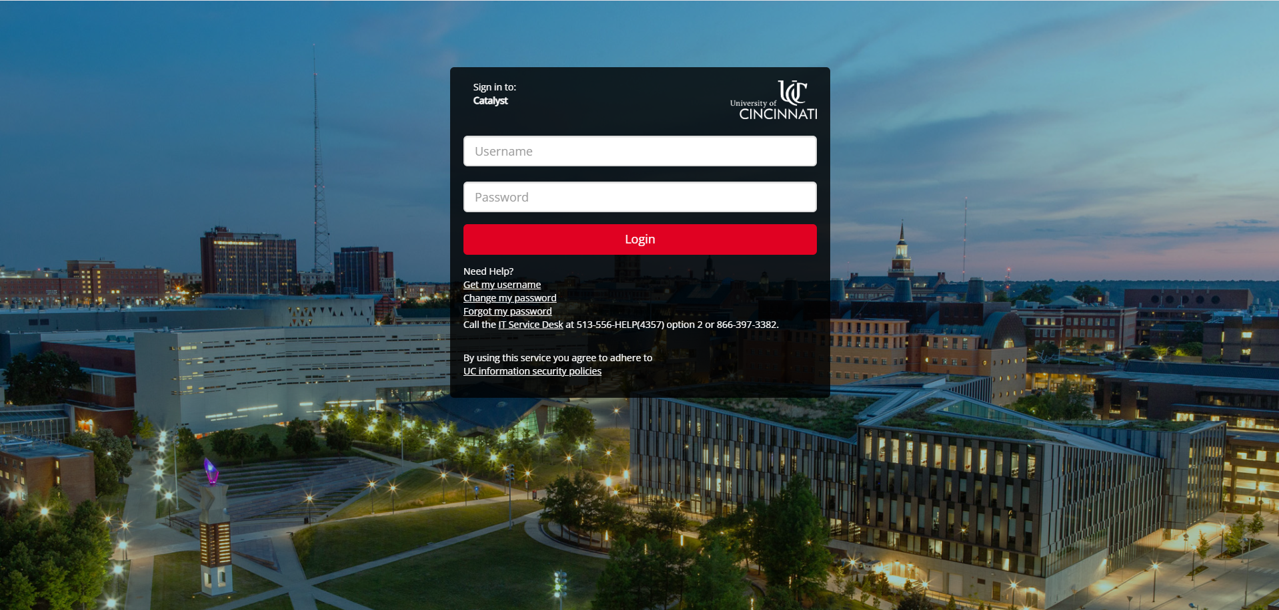
US-exchange
Be your own
Personal Trainer
Get Started
Learn More

Slide 2


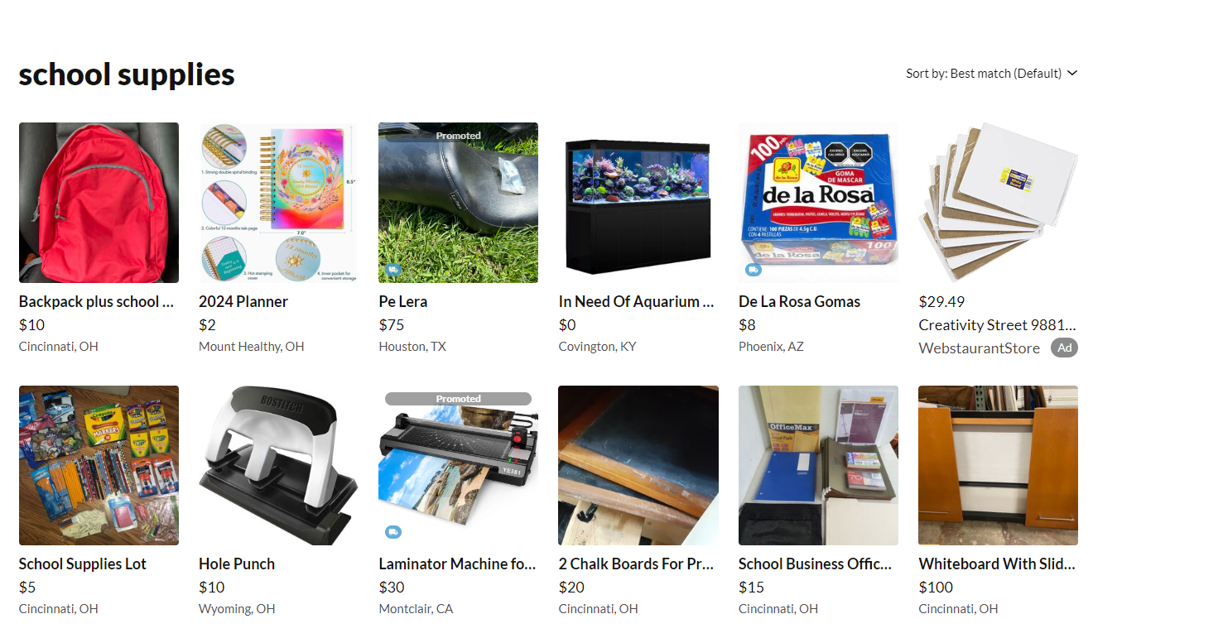
Exchange
About
Buy
Sell
US
Support
Cincinnati: 10 miles

Slide 3
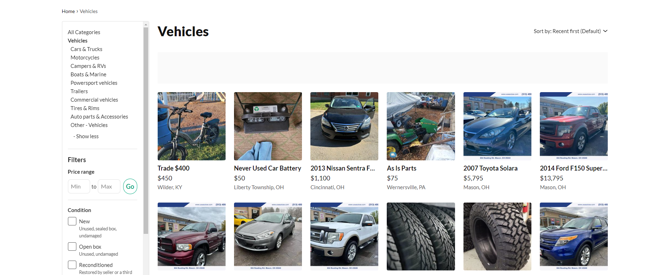
Exchange
About
Buy
Sell
US
Support
Cincinnati: 10 miles

